Slide 1
Module 2
Memory Management, Memory Partitioning

Slide 2
Background
Program must be brought into memory and placed within a process for it to be run
Input queue – collection of processes on the disk that are waiting to be brought into memory to run the program
User programs go through several steps before being run

Slide 3
Binding of Instructions and Data to Memory
Address binding of instructions and data to memory addresses can happen at three different stages
Compile time
Load time
Execution time

Slide 4
Logical vs. Physical Address Space
The concept of a logical address space that is bound to a separate physical address space is central to proper memory management
Logical address – generated by the CPU; also referred to as virtual address
Physical address – address seen by the memory unit

Slide 5
Memory-Management Unit (MMU)
Hardware device that maps virtual to physical address
In MMU scheme, the value in the relocation register is added to every address generated by a user process at the time it is sent to memory
The user program deals with logical addresses; it never sees the real physical addresses

Slide 6
Swapping
A process can be swapped temporarily out of memory to a backing store, and then brought back into memory for continued execution
Backing store
Roll out, roll in
Major part of swap time is transfer time; total transfer time is directly proportional to the amount of memory swapped
Modified versions of swapping are found on many systems (i.e., UNIX, Linux, and Windows)

Slide 7
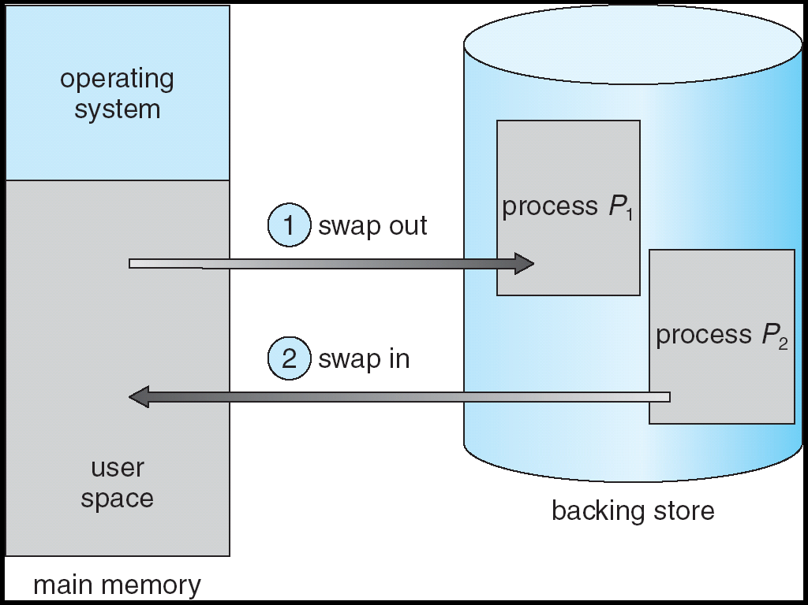
Schematic View of Swapping

Slide 8
Concept of Degree of Multi-programming
The degree of multiprogramming describes the maximum number of processes that a single-processor system can accommodate efficiently
More Process in the RAM
Increases Efficiency

Slide 9
Memory Management Techniques
Contiguous
Non-contiguous
Fixed Partition
Variable Partition
Paging
Inverted Paging
Multi-level Paging
Segmented Paging
Segmentation

Slide 10
Contiguous and Non-contiguous Memory Allocation

Slide 11
Fixed Partitioning/Static Partitioning
Number of partitions are fixed
Size of the partition may or may not be the same
Spanning not allowed
Operating System
Operating System

Slide 12
Fixed Partitioning - Disadvantages
Internal Fragmentation
Limit in Process Size
Degree of Multiprogramming is limited
External Fragmentation
Operating System
Operating System

Slide 13
Variable Partitioning
No internal fragmentation
No limitation on number of processes
No limit on process size
Operating System

Slide 14
Disadvantages
External Fragmentation
Can be avoided by Compaction, but undesirable
Compaction – Time Consuming, Processes has to stop
Allocation and De-allocation is bit complex
As the number of processes are increasing, the holes will also increase
Operating System

Slide 15
Allocation Methods in Contiguous Memory Allocation

Slide 16
Allocation Methods
Operating System
First Fit
Allocate the first hole that is big enough
Next Fit
Same as First Fit but start search always from the last allocated hole
Best Fit
Allocate the smallest hole that is big enough
Worst Fit
Allocate the largest hole

Slide 17
Allocation Methods
Operating System
First Fit
Allocate the first hole that is big enough
Next Fit
Same as First Fit but start search always from the last allocated hole
Best Fit
Allocate the smallest hole that is big enough
Worst Fit
Allocate the largest hole

Slide 18
Non-contiguous Memory Allocation

Slide 19
Non-contiguous allocation
Process (P1)
6 KB
Process will be divided and allocated in different places in Main Memory
Operating System

Slide 20
Concept of Paging
Paging is a storage mechanism that allows OS to retrieve processes from the secondary storage into the main memory in the form of pages
In the Paging method, the main memory is divided into small fixed-size blocks of physical memory, which is called frames
Process is divided into pages
The size of a frame should be kept the same as that of a page to have maximum utilization of the main memory and to avoid external fragmentation

Slide 21
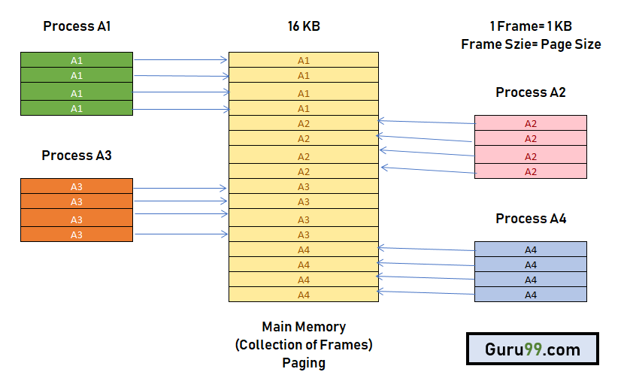
Concept of Paging

Slide 23
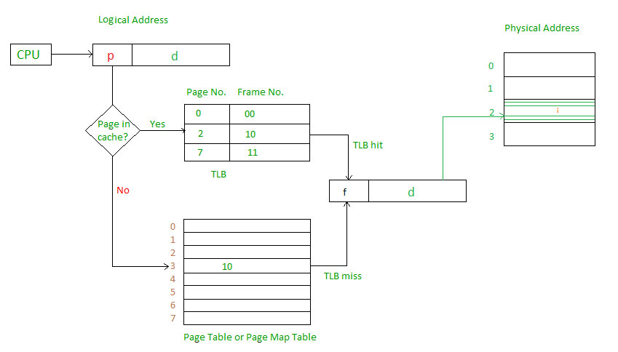
How Paging Works?

Slide 24
How Paging Works?

Slide 25
Advantages and Disadvantages of Paging
Paging reduces external fragmentation, but still suffer from internal fragmentation.
Paging is simple to implement and assumed as an efficient memory management technique.
Due to equal size of the pages and frames, swapping becomes very easy.
Page table requires extra memory space, so may not be good for a system having small RAM.

Slide 26
Segmentation

Slide 27
Segmentation
Segmentation is a memory management technique in which, the memory is divided into the variable size parts
Segmentation method works almost similarly to paging, only difference between the two is that:
segments are of variable-length
pages are always of fixed size

Slide 29
How segmentation works?
0
Operating System
1500
Segment Number | Base Address | Size (Limit)
0 | 3300 | 200
1 | 1800 | 400
2 | 2700 | 600
3 | 2300 | 400
4 | 2200 | 100
5 | 1500 | 300
S5
1800
Yes
S1
<=
+
2200
S4
2300
No
S3
2700
TRAP
S2
3300
S0
3500

Slide 31
Advantages of Segmentation
No internal fragmentation
Average Segment Size is larger than the actual page size.
Less overhead
It is easier to relocate segments than entire address space.
The segment table is of lesser size as compare to the page table in paging.

Slide 32
Disadvantages of Segmentation
It can have external fragmentation.
it is difficult to allocate contiguous memory to variable sized partition.
Costly memory management algorithms.

Slide 33
Virtual memory

Slide 34

Background
Virtual memory – separation of user logical memory from physical memory.
Only part of the program needs to be in memory for execution.
Logical address space can therefore be much larger than physical address space.
Allows address spaces to be shared by several processes.
Allows for more efficient process creation.
Virtual memory can be implemented via:
Demand paging
Demand segmentation

Slide 36
Process Creation
Virtual memory allows other benefits during process creation:
- Copy-on-Write
- Memory-Mapped Files

Slide 37
Copy-on-Write
Copy-on-Write (COW) allows both parent and child processes to initially share the same pages in memory. If either process modifies a shared page, only then is the page copied.
COW allows more efficient process creation as only modified pages are copied.
Free pages are allocated from a pool of zeroed-out pages.
Technique called zero-fill-on-demand.

Slide 38
Memory-Mapped Files
Memory-mapped file I/O allows file I/O to be treated as routine memory access by mapping a disk block to a page in memory.
A file is initially read using demand paging. A page-sized portion of the file is read from the file system into a physical page. Subsequent reads/writes to/from the file are treated as ordinary memory accesses.
Simplifies file access by treating file I/O through memory rather than read() write() system calls.
Also allows several processes to map the same file allowing the pages in memory to be shared.

Slide 39
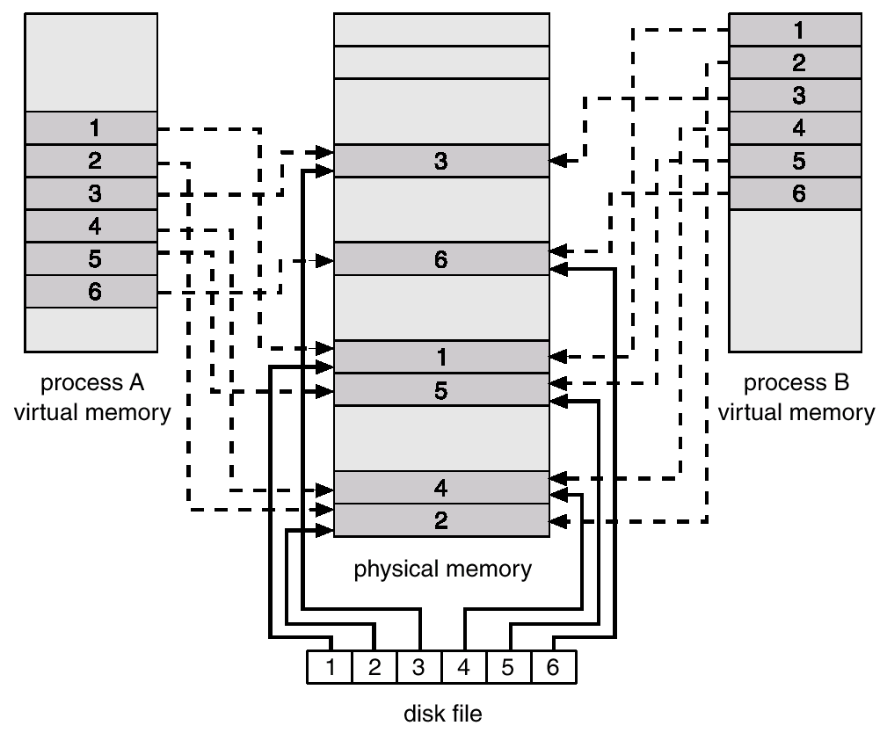
Memory Mapped Files

Slide 40
Demand Paging
Bring a page into memory only when it is needed
Less memory needed
Faster response
More users
Page is needed ⇒ reference to it
invalid reference ⇒ abort
not-in-memory ⇒ bring to memory

Slide 41
Valid-Invalid Bit
With each page table entry a valid–invalid bit is associated (1 ⇒ in-memory, 0 ⇒ not-in-memory)
Initially valid–invalid but is set to 0 on all entries
Example of a page table snapshot:
During address translation, if valid–invalid bit in page table entry is 0 ⇒ page fault
Frame #
valid-invalid bit
1
1
1
1
0

0
0
page table

Slide 42
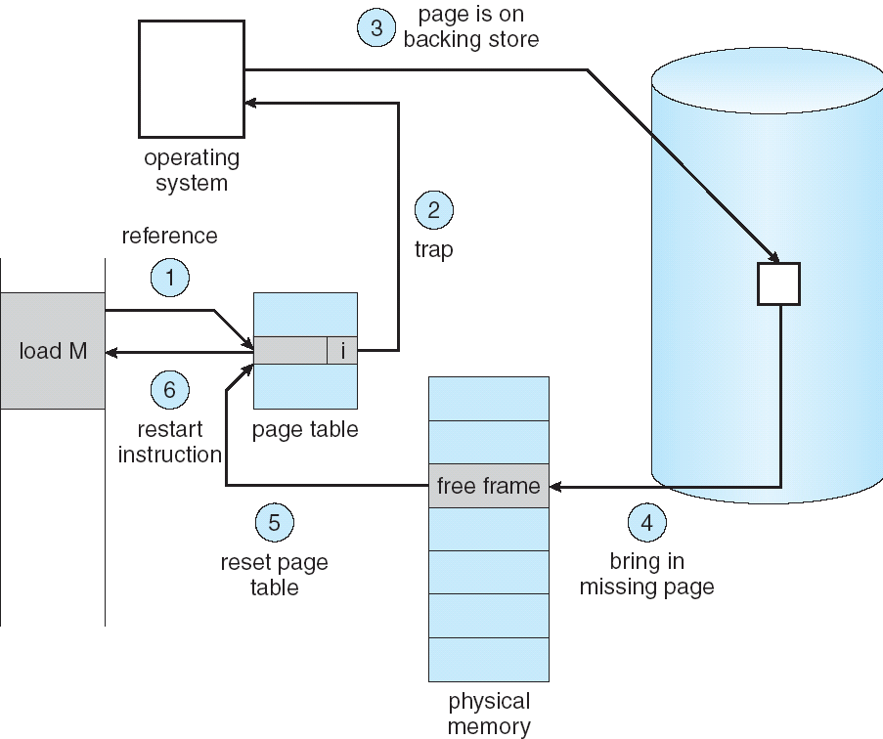
Steps in Handling a Page Fault

Slide 43
What happens if there is no free frame?
Page replacement – find some page in memory, but not really in use, swap it out
algorithm
performance – want an algorithm which will result in minimum number of page faults
Same page may be brought into memory several times

Slide 44
Performance of Demand Paging
Page Fault Rate 0 ≤ p ≤ 1.0
if p = 0 no page faults
if p = 1, every reference is a fault
Effective Access Time (EAT)
EAT = (1 – p) x memory access
+ p x page fault time

Slide 45
Demand Paging Example
Memory access time = 100 nanosecond
Average pagefault service time=25 millisecond
EAT(ns)=(1-p) x(100) + (25 milliseconds)
= (1-p)x100+px2500000
=100+24999900 x p
EAT is directly proportional to page fault rate
If one access out of 1,000 causes a page fault, then
EAT = 25 microseconds.
This is a slowdown by a factor of 250!!

Slide 46
Basic Page Replacement
Find the location of the desired page on disk
Find a free frame: - If there is a free frame, use it - If there is no free frame, use a page replacement algorithm to select a victim frame
Read the desired page into the (newly) free frame. Update the page and frame tables.
Restart the process

Slide 48
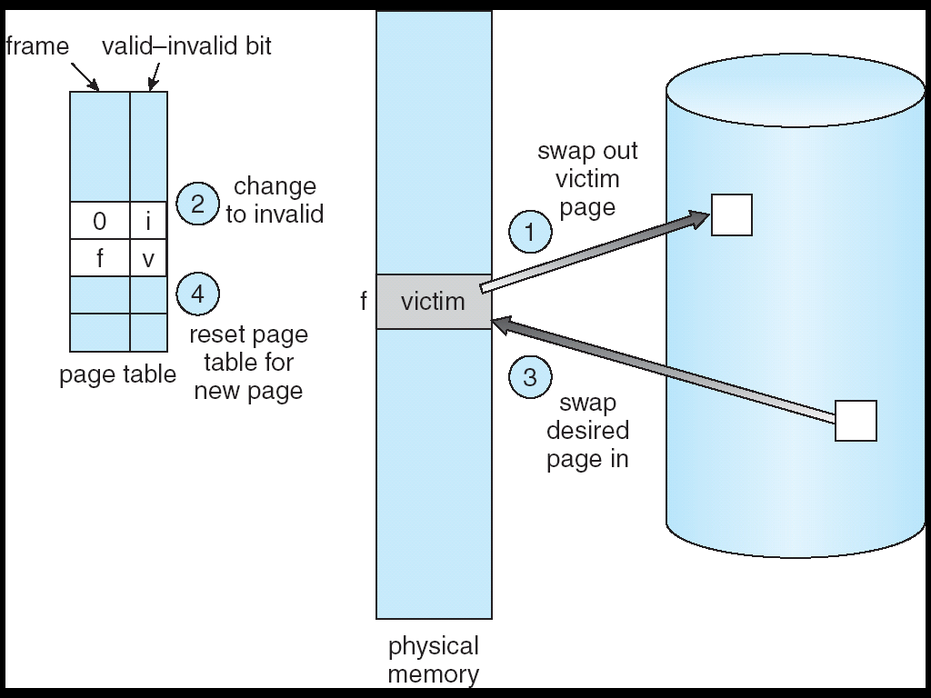
Page Replacement

Slide 49
Page Replacement Algorithms
Want lowest page-fault rate
Evaluate algorithm by running it on a particular string of memory references (reference string) and computing the number of page faults on that string

Slide 50
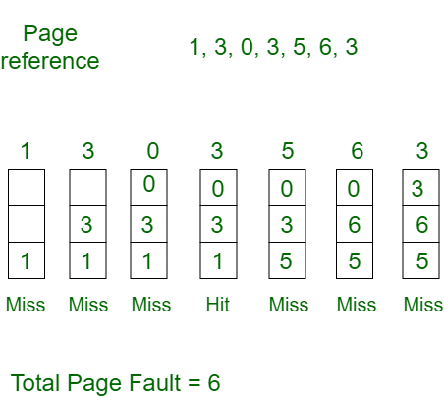
Page Replacement Algorithms
First In First Out (FIFO)
This is the simplest page replacement algorithm
The page first entered in the memory will be replaced first

Slide 51
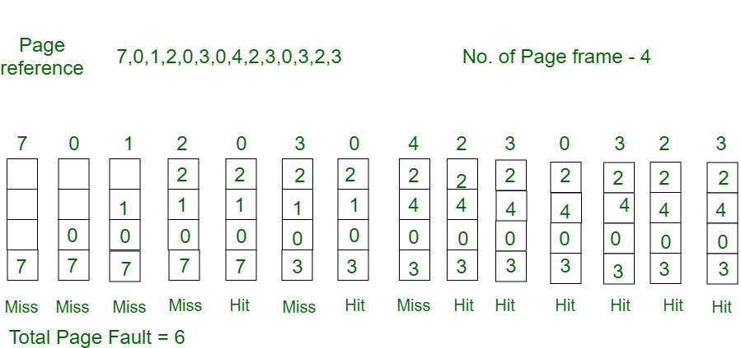
Page Replacement Algorithms
Optimal Page Replacement
pages are replaced which would not be used for the longest duration of time in the future.

Slide 52
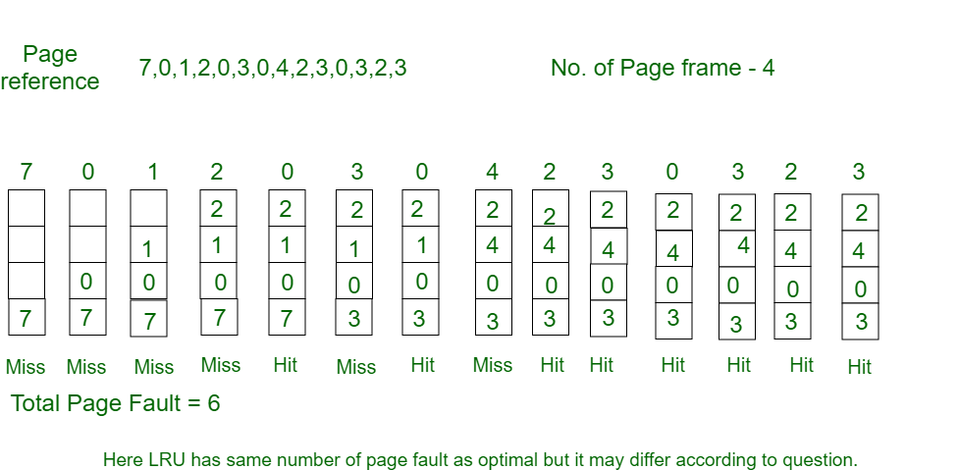
Page Replacement Algorithms
Least Recently Used Algorithm
In this algorithm page will be replaced which is least recently use

Slide 53
Allocation of Frames
Each process needs minimum number of pages defined by the architecture
Maximum no. is defined by the amount of available physical memory
Two major allocation schemes
fixed allocation
priority allocation

Slide 54
Fixed Allocation
Equal allocation – For example, if there are 100 frames and 5 processes, give each process 20 frames.
Proportional allocation – Allocate according to the size of process

Slide 55
Priority Allocation
Use a proportional allocation scheme using priorities rather than size
If process P_{i} generates a page fault,
select for replacement one of its frames
select for replacement a frame from a process with lower priority number

Slide 56
Global vs. Local Allocation
Global replacement – process selects a replacement frame from the set of all frames; one process can take a frame from another
Local replacement – each process selects from only its own set of allocated frames

Slide 57
Thrashing
If a process does not have “enough” pages, the page-fault rate is very high. This leads to:
low CPU utilization
operating system thinks that it needs to increase the degree of multiprogramming
another process added to the system
Thrashing ≡ a process is busy swapping pages in and out

Slide 58
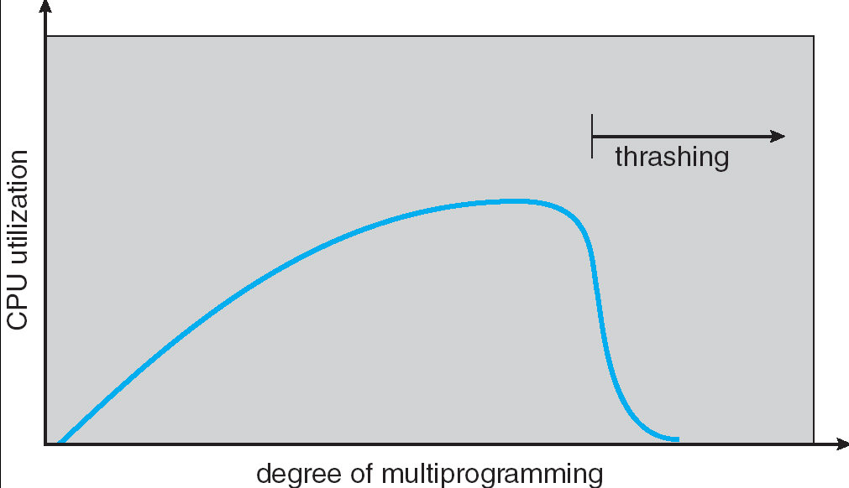
Thrashing (Cont.)

Slide 59
Effects of thrashing can be reduced by local replacement algorithm
Locality model
Process migrates from one locality to another
Localities may overlap
Why does thrashing occur? Σ size of locality > total memory size

Slide 60
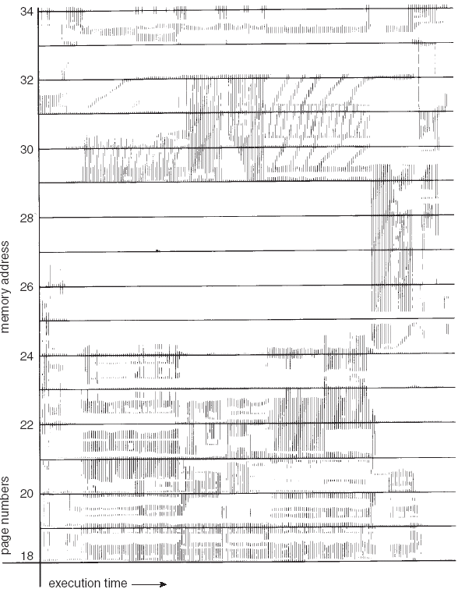
Locality In A Memory-Reference Pattern

Slide 61
Working-Set Model
Δ ≡ working-set window ≡ a fixed number of page references Example: 10,000 instruction
WSS_{i} (working set of Process P_{i}) = total number of pages referenced in the most recent Δ (varies in time)
if Δ too small will not encompass entire locality
if Δ too large will encompass several localities
if Δ = ∞ ⇒ will encompass entire program
D = Σ WSS_{i} ≡ total demand frames
if D > m ⇒ Thrashing
Policy if D > m, then suspend one of the processes

Slide 62
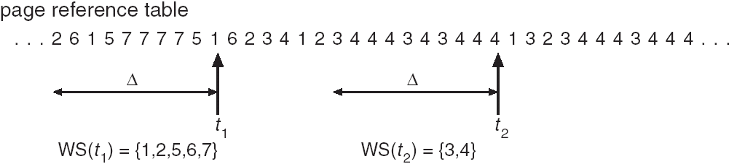
Working-set model

Slide 63
Keeping Track of the Working Set
Approximate with interval timer + a reference bit
Example: Δ = 10,000
Timer interrupts after every 5000 time units
Keep in memory 2 bits for each page
Whenever a timer interrupts copy and sets the values of all reference bits to 0
If one of the bits in memory = 1 ⇒ page in working set
Why is this not completely accurate?
Improvement = 10 bits and interrupt every 1000 time units

Slide 64
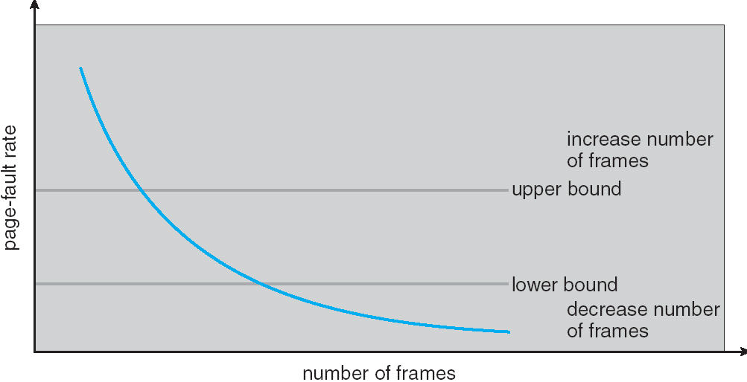
Page-Fault Frequency Scheme
Establish “acceptable” page-fault rate
If actual rate too low, process loses frame
If actual rate too high, process gains frame

